Slide 1
Using Monte Carlo Simulations to estimate PI
Sahil Gurugunti, Deivanayagam Shanmugasundaram, Aashneil Uppuluri, Neha Agarwal

Slide 2
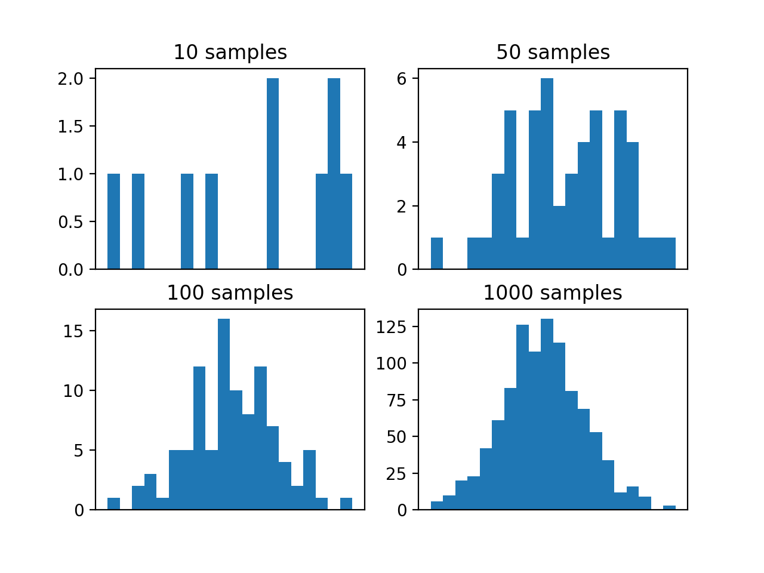
What is the Monte Carlo Simulation
Used to model the probability of different outcomes
Circumvents the obstacles placed by the intervention of random variables
Used to understand impact of risk and uncertainty in prediction and forecasting
Can be used in virtually every field
Also referred as multiple probability simulation

Slide 3
Estimating Pi using Monte Carlo Simulation
In order to estimate PI using Monte Carlo Simulations, which is a computational algorithm which utilizes repeated random sampling to achieve a numerical result.
The thought behind the code is to simulate random X and Y variables on a 2D plane the size of one unit. On this domain is a circle enclosed in a square; we calculate a ratio of points both in the circle and in the square.
So, our code populates the graph with a very large number of generated points, and estimates PI as a numerical result.

Slide 4
Methods
Hypothesis: The greater the number of iterations run, the greater accuracy of PI we achieve .
Data: We use N=1,000,000 runs to get 1,000,000 x values and 1,000,000 y values, and define our x range and y range to be [-1,1].
Steps: We first randomly sample 1,000,000 x values and y values each.
Then we use the equation of a circle(with ≤): x^2+y^2 ≤r^2 where r=1, to find out how many points are in the circle.
We use the ratio of the points in the circle to the total number of points and multiply this ratio by 4 to achieve an empirical approximation of PI. The ratio of the points in a circle is the area of a circle which is 𝞹r^2, and the total number of pints is the area of the square with is 4r^2. Thus, taking the ratio and multiplying by 4 gives pi theoretically.

Slide 5
Code
N <- 1000000
R <- 1
x <- runif(N, min= -R, max= R)
y <- runif(N, min= -R, max= R)
is.inside <- (x^2 + y^2) <= R^2
pi.estimate <- 4 * sum(is.inside) / N
pi.estimate
plot.new()
plot.window(xlim = 1.1 * R * c(-1, 1), ylim = 1.1 * R * c(-1, 1))
points(x[ is.inside], y[ is.inside], pch = '.', col = "blue")
points(x[!is.inside], y[!is.inside], pch = '.', col = "red")

Slide 6
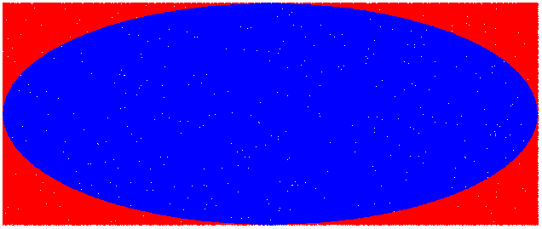
Results 1
After running the code for the first time, we are presented with the graph shown here. If we take all the points that fall within the circle (785,555) and divide it by the total points (1,000,000) and multiply it by 4 we get a number that is ~ π. In this case we got 3.14222.

Slide 7
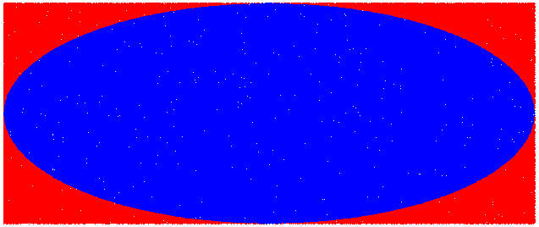
Results 2
For our second result we have 785,541 points in the circle out of the 1,000,000. When applying our formula from before, we get a value of 3.142164.

Slide 8

Results 3
For the last run we got 785,390 points that fall in the blue circle out of the 1,000,000 total random points. After the formula is applied we get a number of 3.14156.

Slide 9
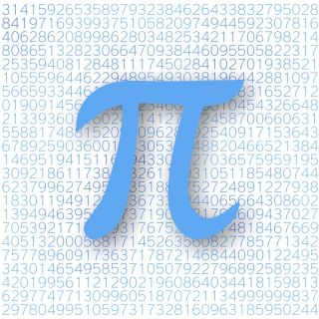
Overall Results
After running the code three different times we can see that the average is 3.14198133333 which is fairly close to the actual value of pi which is 3.14159265359. Obviously if we were able to run more simulations and increase the amount of dots, we would be significantly closer to the actual value of pi.

Slide 10
Discussion
We can first state that we know the area of both a square and circle, and once applying the proper algorithm, we can generate a substantial amount of points that lay within the circle.
From running the Monte Carlo Simulation in relation to the estimation of PI, the greater the number of iterations run, the greater the accuracy of PI we achieve. Our results proved what we initially thought, and can definitely be applied to many fields when it comes to differentiating outcomes.
If we had the chance to run this again, it would be interesting to see the exact range of iterations it would take in order to more closely estimate the value of PI. The effect of the Monte Carlo simulation on circumstances where probability of outcomes can be used for analytical or research purposes is very beneficial.
There was a study done by Barth-Jones Et al., showing how the use of a monte carlo simulation came into effect when analyzing the effectiveness of HIV vaccines in terms of transmission. Through the simulation, the authors were able to see that there can be proper estimates made on factors like vaccine effects (VE) and vaccine effects on susceptibility (VEs) to an accurate degree, given a proper sample size.
Link to study

